Slide 1
The Earth and Plate Tectonics
Chapter
1
Learning outcomes: 1.1

Slide 2
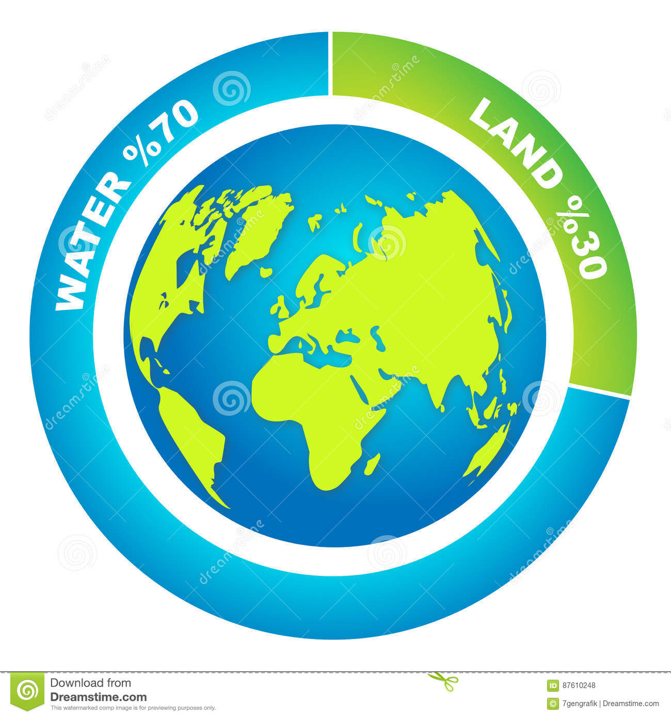
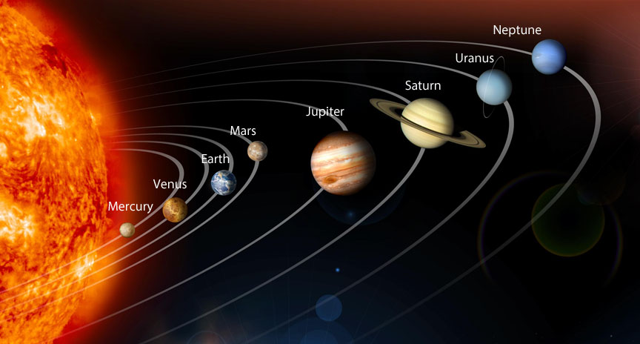
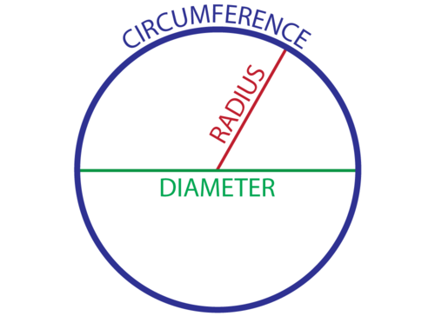
EARTH FACT FILE
https://www.youtube.com/watch?v=kIID5FDi2JQwhy maps are wrong
Third planet in the solar system – 150 million km from the sun
Approximately 29 per cent land and 71 per cent water
Circumference at the equator – 40,076 km
Journey to the centre of the Earth – 6,370 km
Weighs 5.97 trillion trillion kg
Spins at 1,670 km/hr
Orbits the sun at 30 km/s

Slide 3
At the end of this chapter, you will be able to:
1.1 Describe the layers (structure) of the Earth.
1.2 Explain convection currents and how they move the Earth’s plates.
1.3 Explain the idea of plate tectonics.
1.4 Describe the three different plate boundaries.

Slide 4
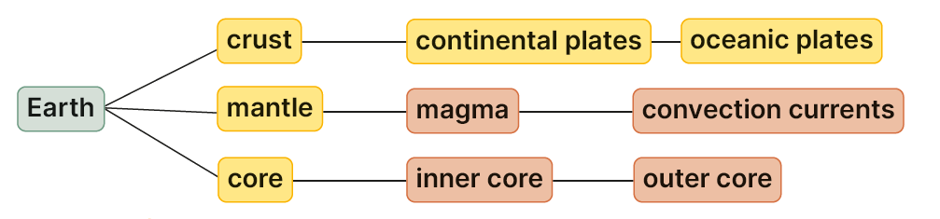
Keyword connections

Slide 5
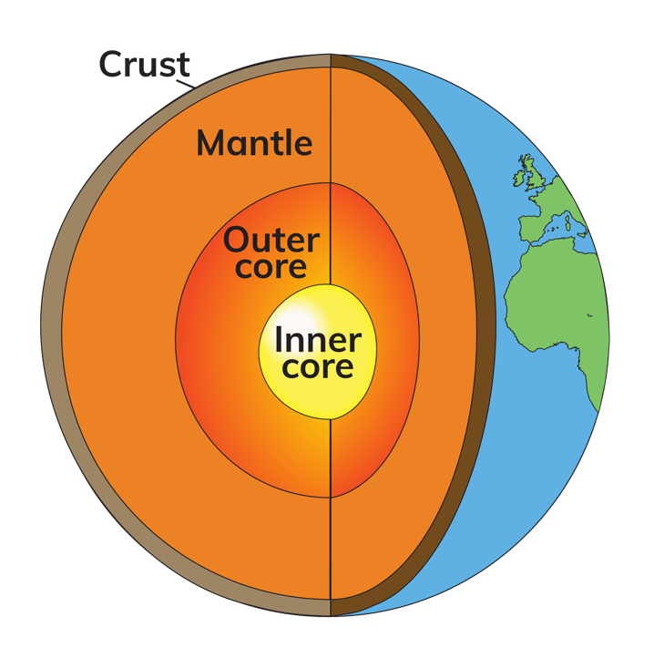
1.1 Describe the layers (structure) of the Earth.
1. The core
nickel and iron
5,000°C
inner core – solid
outer core – molten
2. The mantle
4,000°C
molten rock called magma
3. The crust
solid rock
continents – up to 100 km thick
ocean floor – up to 10 km thick
floats on the magma in the mantle
broken into tectonic plates

Slide 6
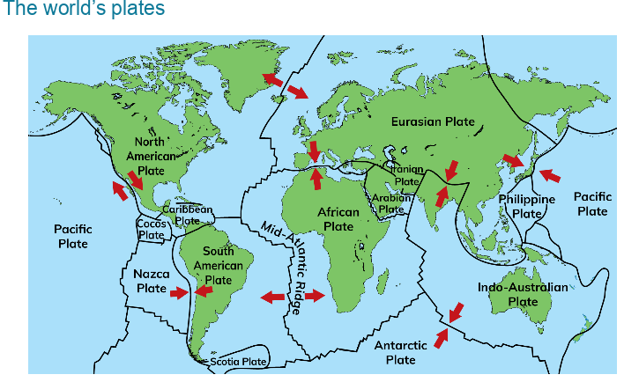
https://www.youtube.com/watch?v=kIID5FDi2JQwhy maps are wrong

Slide 7
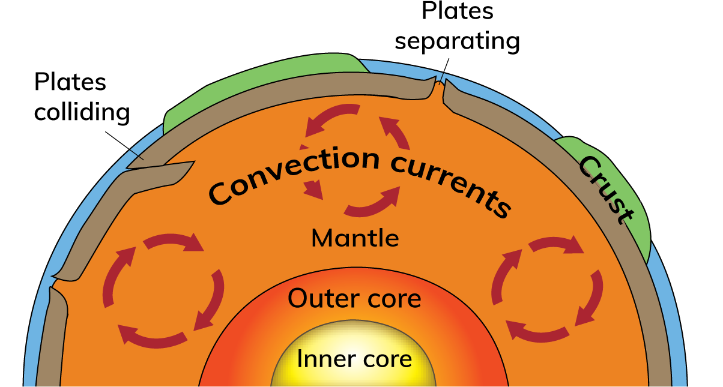
1.2 Explain convection currents and how they move the Earth’s plates.
1. Magma in the mantle is heated. It becomes lighter and rises.
2. When the hot magma reaches underneath the crust, it spreads out in all directions, dragging the crust with it.
3. The magma then cools slightly, sinks through the mantle and starts to heat up again.
4. This cycle is repeated again and again in a circular motion, causing convection currents.
https://www.youtube.com/watch?v=p0dWF_3PYh4&t=30s

Slide 8
1.1 Describe the layers (structure) of the Earth.
1.2 Explain convection currents and how they move the Earth’s plates.
Go to Sections 1.1 and 1.2 on page 1 of your Skills Book.

Slide 9
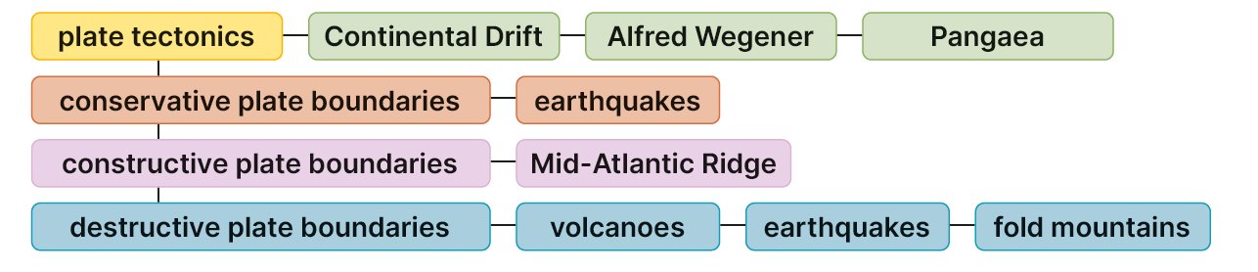
1.3 Explain the idea of plate tectonics.
Keyword connections

Slide 10
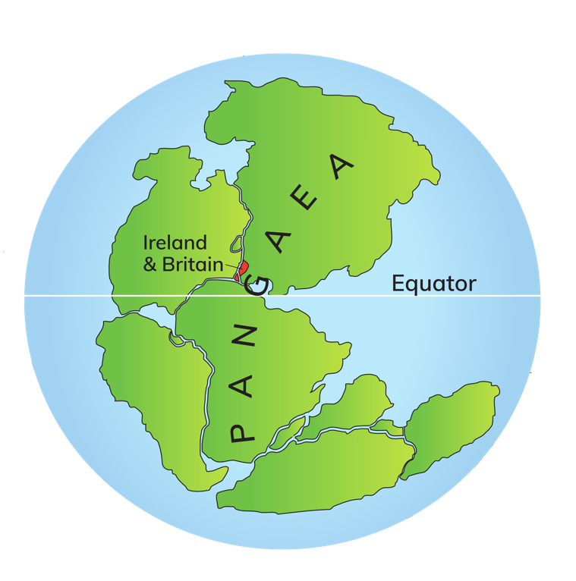
1.3 Explain the idea of plate tectonics.
1. First studied in 1912 by Alfred Wegener.
2. 200 million years ago all the continents were joined together in one landmass called Pangaea.
3. Wegener thought that the continents moved. He called this theory of plate movement Continental Drift.
4. By 65 million years ago, the continents had reached their present-day locations.
5. Wegener could not explain how the plates moved.

Slide 11
1.3 Explain the idea of plate tectonics.
6. In the 1960s, earth scientists discovered that there were places under the ocean where the seafloor was spreading.
7. This theory was called seafloor spreading.
8. The continents sit on plates. The plates move.
9. Plate tectonics is a theory that explains the movement of plates.
Convection currents drag the plates of the crust together, apart, or side by side.
https://youtu.be/XkODbyTVR5I Zac Efron Iceland

Slide 12

1.1, 1.2 and 1.3
1. Name the three layers of the Earth.
2. What does the term ‘molten’ mean?
3. What is magma?
4. What is continental drift?
5. What are convection currents?

Slide 13
1.1, 1.2 and 1.3
Higher-order questions 1
1. Why do continents lie above the ocean floor?
2. Where will the continents be in another 200 million years?
3. Why did Wegener call the supercontinent ‘Pangaea’?

Slide 14
1.3 Explain the idea of plate tectonics.
Go to Section 1.3 on page 2 of your Skills Book.

Slide 15
1.4 Describe the three different plate boundaries.
1. The crust of the Earth is like a huge jigsaw and is broken into pieces called plates.
2. There are two types of plate – oceanic plates and continental plates.
3. The edges of the plates are called plate boundaries.
4. Plates meet at plate boundaries where they are separated by faults (cracks) in the crust.
5. Convection currents in the mantle cause the plates to move.

Slide 16
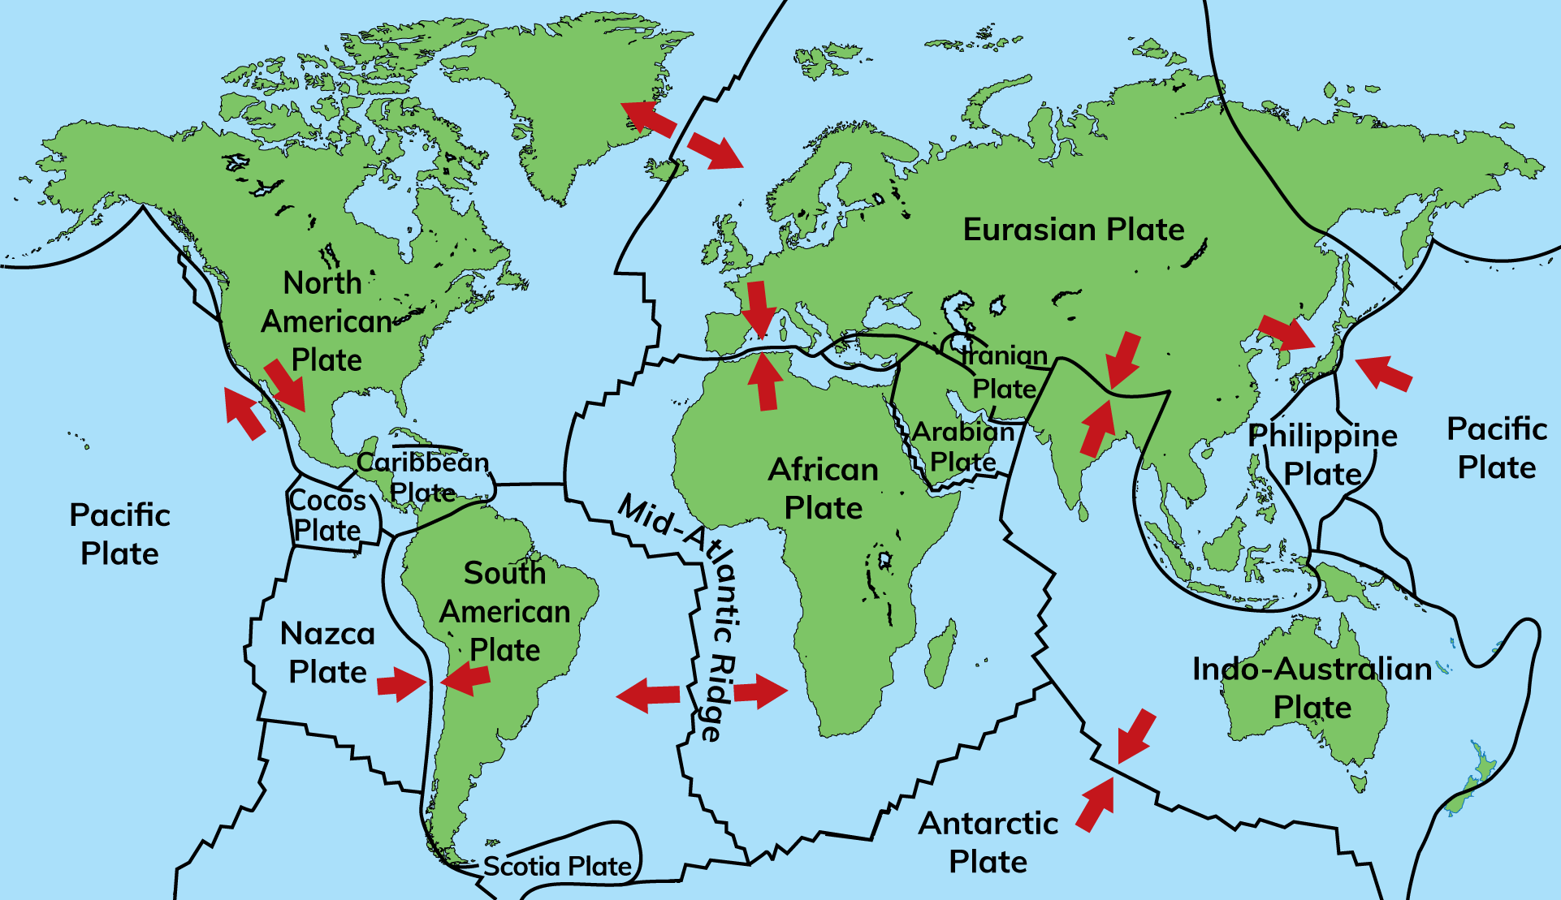

1.4 Describe the three different plate boundaries.
1. Name two separating plates.
2. Name two colliding plates.
3. Name two plates that are moving side by side.
4. On what plate is Ireland found?
5. What do you notice about the names of the plates?

Slide 17
Learning Outcome 1.4:
Describe the three different plate boundaries.
Remember!!
There are 2 types of plate:
continents – up to 100 km thick
ocean floor – up to 10 km thick
Which do you think is heavier?

Slide 18
Describe the three different plate boundaries.
https://www.youtube.com/watch?v=oCPjgv2Pccc
 | Constructive plate boundary | Destructive plate boundary | Conservative plate boundary
Type of boundary (arrows)
Other names
Where does it happen?
What happens?
Features
Real-world examples

Slide 19
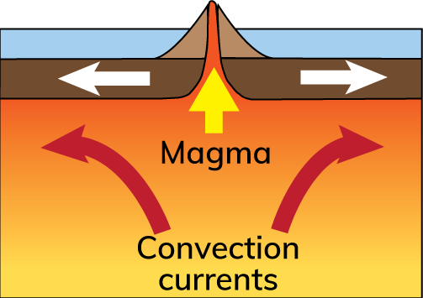
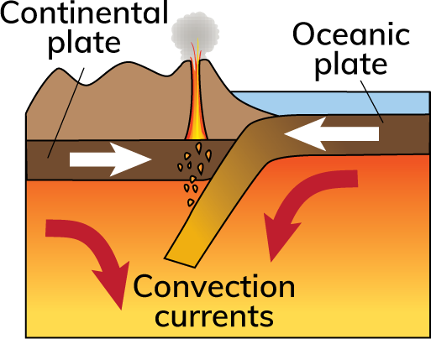
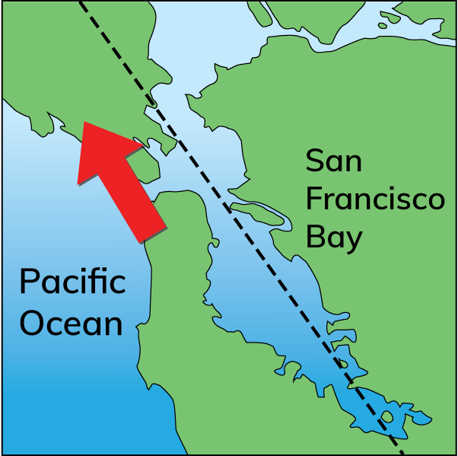
 | Constructive plate boundary | Destructive plate boundary | Conservative plate boundary
Type of boundary (arrows)
Other names | Divergent Plate Boundary/Margin | Convergent Plate Boundary / Margin | Passive Plate Boundary /Margin/ Transform Boundary
Where does it happen? | two plates are moving away from each other. | two plates collide. | plates move side by side.
What happens? | Two plates are pulled apart by convection currents. Molten magma comes to the surface through a crack called a fissure. This creates new land. | Convection currents cause two plates to collide. The heavier plate sinks into the mantle and is destroyed. The lighter plate buckles upwards, creating fold mountains and sometimes volcanoes. | Two plates move side by side. They can move in opposite directions or in the same direction but at different speeds. Sometimes the plates get stuck. Eventually they slip forward suddenly. The energy released creates an earthquake.
Features | New land Volcanoes Mid-ocean ridges Volcanic islands Earthquakes | Fold mountains Volcanoes Earthquakes | Earthquakes
Real-world examples | Mid-Atlantic Ridge runs through Iceland | Andes Mountains in South America | San Andreas Fault, USA

Slide 20
1.4 Describe the three different plate boundaries.
Constructive plate boundaries
Convection currents drag tectonic plates apart
Process called seafloor spreading.
Molten magma comes to the surface through a crack called a rift.
Magma hardens on contact with sea water
Forms a ridge
This constructs (builds) new oceanic crust
If plates separate on land, this produces a rift valley.
Landforms at constructive plate boundaries
Volcanoes, volcanic islands and mid-ocean ridges.
Processes at constructive plate boundaries
Earthquakes.
Example: The Mid-Atlantic Ridge
Eurasian Plate is separating from the North American Plate.

Slide 21
1.4 Describe the three different plate boundaries.
Destructive plate boundaries
Occur where two plates collide.
Convection currents drag an oceanic and continental plate towards each other.
The oceanic plate is heavier and sinks into the mantle, where it melts.
The continental plate buckles upwards, forms fold mountains and sometimes volcanoes.
Landforms at destructive plate boundaries
Fold mountains, volcanoes and volcanic island arcs.
Earthquakes also occur at destructive plate boundaries.
Example: The Andes, South America
The oceanic Nazca Plate collided with the continental South American Plate.

Slide 22
1.4 Describe the three different plate boundaries.
Conservative plate boundaries
Where plates move side by side.
Convection currents can move two plates
In opposite directions, or
In the same direction but at different speeds.
Sometimes the plates get stuck.
Eventually they slip forward suddenly.
The energy released creates an earthquake.
Example: The San Andreas Fault system. This series of faults (smaller cracks in the crust) marks the boundary between the Pacific Plate and the North American Plate.

Slide 23

1.4 Describe the three different plate boundaries.
1. Name the three types of plate boundary.
2. At which types of plate boundary do fold mountains form?
3. What is a mid-ocean ridge?
4. At which plate boundaries do volcanoes form?
5. At which plate boundaries do earthquakes occur?

Slide 24
1.4 Describe the three different plate boundaries.
Higher-order questions 3
1. Is it possible for plates to move up and down?
2. Ireland is not on the edge of any plate. Does this mean we do not have fold mountains?
3. What would happen if convection currents stopped circulating?

Slide 25
1.4 Describe the three different plate boundaries.
Go to Section 1.4 on page 2 of your Skills Book.

Slide 26
Assess your progress
Go to page 4 of your Skills Book and assess your progress.
1.1 Describe the layers (structure) of the Earth.
1.2 Explain convection currents and how they move the Earth’s plates.
1.3 Explain the idea of plate tectonics.
1.4 Describe the three different plate boundaries.
Identify any gaps in your learning. Use the Rapid Revision on page 7 of your Textbook to jog your memory.

